Slide 1
Homeli- Foodi
Home made food ordering
By,
Amal Vijayan
Roll no.10
AJC20MCA-2011
S3 RMCA A

Slide 2
Contents
Abstract
Project Modules
UML Diagrams
Table Design
Conclusion

Slide 3
Abstract
Homeli-foodi

Slide 4
Homeli-foodi
Homeli foodi is a food delivery app for homemade foods that are prepared by home chefs.
It includes the ordering and delivery of homely foods from the home chefs which is not listed in the existing food delivery system.
The system consists of Admin, User, Home chefs.
The users can place order for foods that are available, and the food is delivered to them by the delivery agents.

Slide 5
Project Modules
The System consists of 3 modules
Admin
Chefs
Customers

Slide 6
Admin
This module overall manages the web application.
They have rights to view the chefs and customer details.
They have authority to enable and disable chefs and customer.
Admin can view status of orders and foods in the system

Slide 7
Chefs
Chefs can add foods to the system and update existing items.
They can view orders for them and manage it .
They have authority to accept or reject the order requests.
Also they can view all the available foods in the system

Slide 8
Customers
Customers can order food items.
They have the authority to update their profile.
They are able to see the order status.
They can manage cart and orders.

Slide 9
UML DIAGRAMS

Slide 10
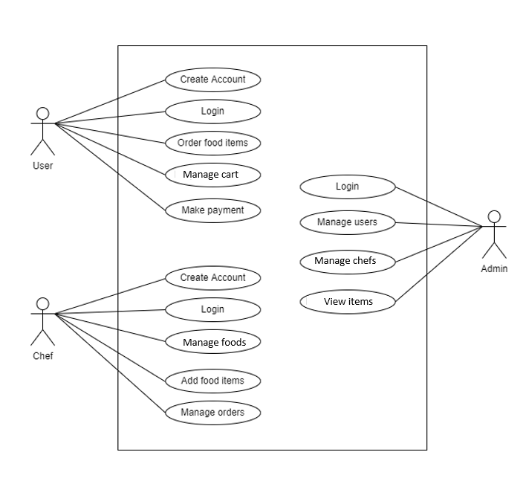
Use case diagram

Slide 11
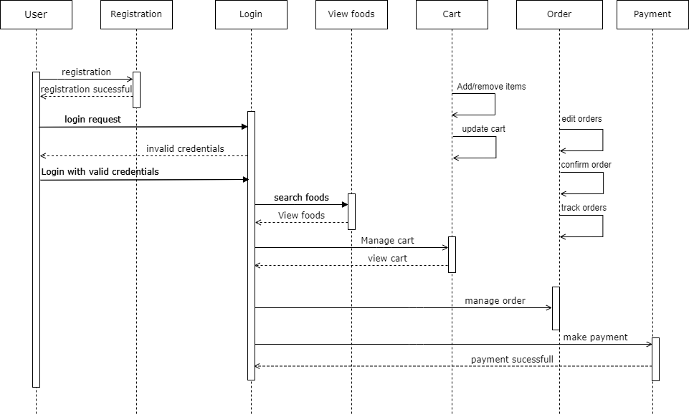
Sequence diagram

Slide 12
Table Design

Slide 13
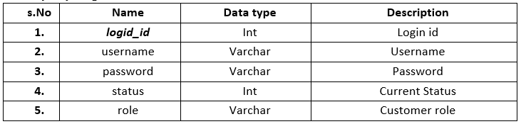
Tables
Tbl_login
Primary key: logid

Slide 14
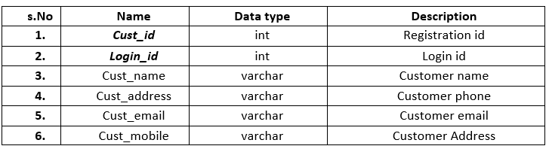
customers
Primary key: customers
Foreign key login_d references table tbl_login

Slide 15
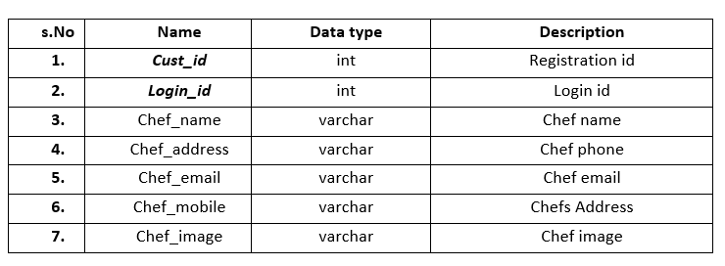
Tbl_chefs
Primary key: chefs_id
Foreign key login_d references table tbl_login

Slide 16
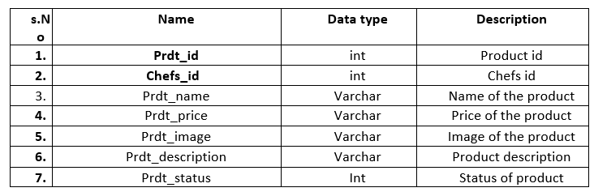
products
Primary Key: prdt_id
Foreign Key chefs_id references tbl_chefs

Slide 17
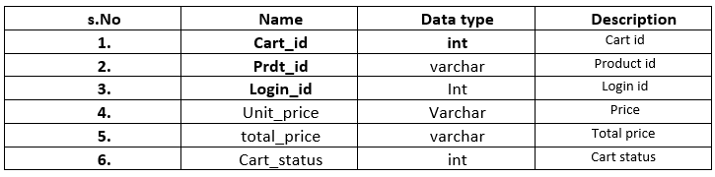
cart
Primary key cart_id
Foreign Key prdt_id references products
Foreign Key login_id references tbl_login

Slide 18
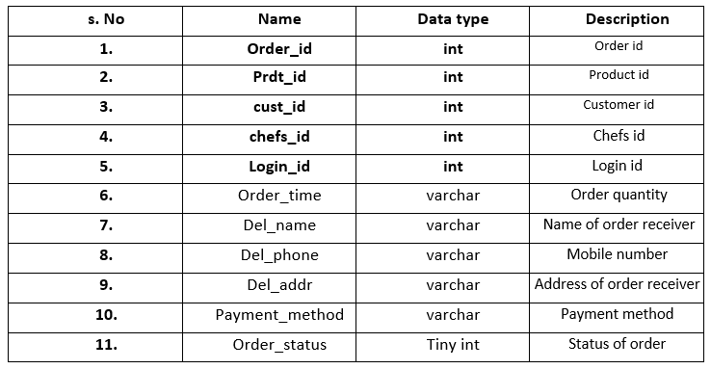
Orders
Primary key order_id
Foreign Key prdt_id references products, Foreign Key cust_id references customers
Foreign Key chefs_id references tbl_chefs, Foreign Key login_id references tbl_login

Slide 19
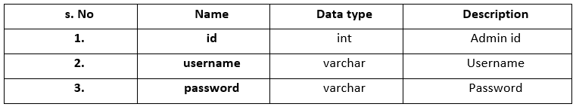
Admin_users
Primary key: id

Slide 20
Thank you

